Slide 1


Reliability
數據所 李易庭
統計所 黃群翔

Slide 2
Reliability concept
Reliability Function
Likelihood censor
Common Distribution
Bootstrap
Degradation
Example

Slide 3

Reliability Concept

Slide 4
Quality vs Reliability
The difference between quality and reliability is that quality shows how well an object performs its proper function, while reliability shows how well this object maintains its original level of quality over time, through various conditions.
Asking a few key questions can help one determine the difference between both quality and reliability:
Quality = Does the object perform its intended function? If so, how well does it perform its intended function?
Reliability = To what level has said object maintained this level of quality over time?

Slide 5
Uncertainties of Failure
In theory, if we were able to comprehend and understand the mechanisms of failure processes, then we would be able to predict failures with certainty.
In practice, we have limited knowledge of the physical state of the system, a lack of understanding of the physical processes and chemical reactions that cause failure, and the randomness of external events.
Thus, failures appear to be random. However, this randomness may exhibit some pattern that can be modeled by some probability distribution. We can, therefore, predict failures statistically.

Slide 6
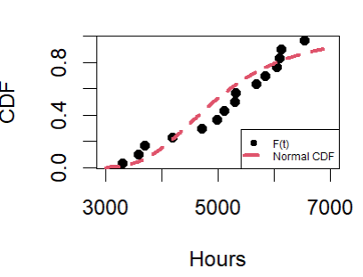
Acceleration
Acceleration factors show how time-to-fail at a particular operating stress level (for one failure mode or mechanism) can be used to predict the equivalent time to fail at a different operating stress level.
Reliability Data

Slide 7
Reliability Function

Slide 8
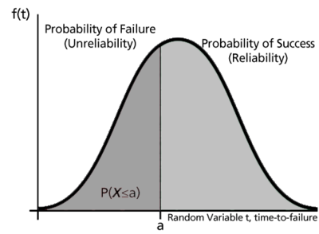
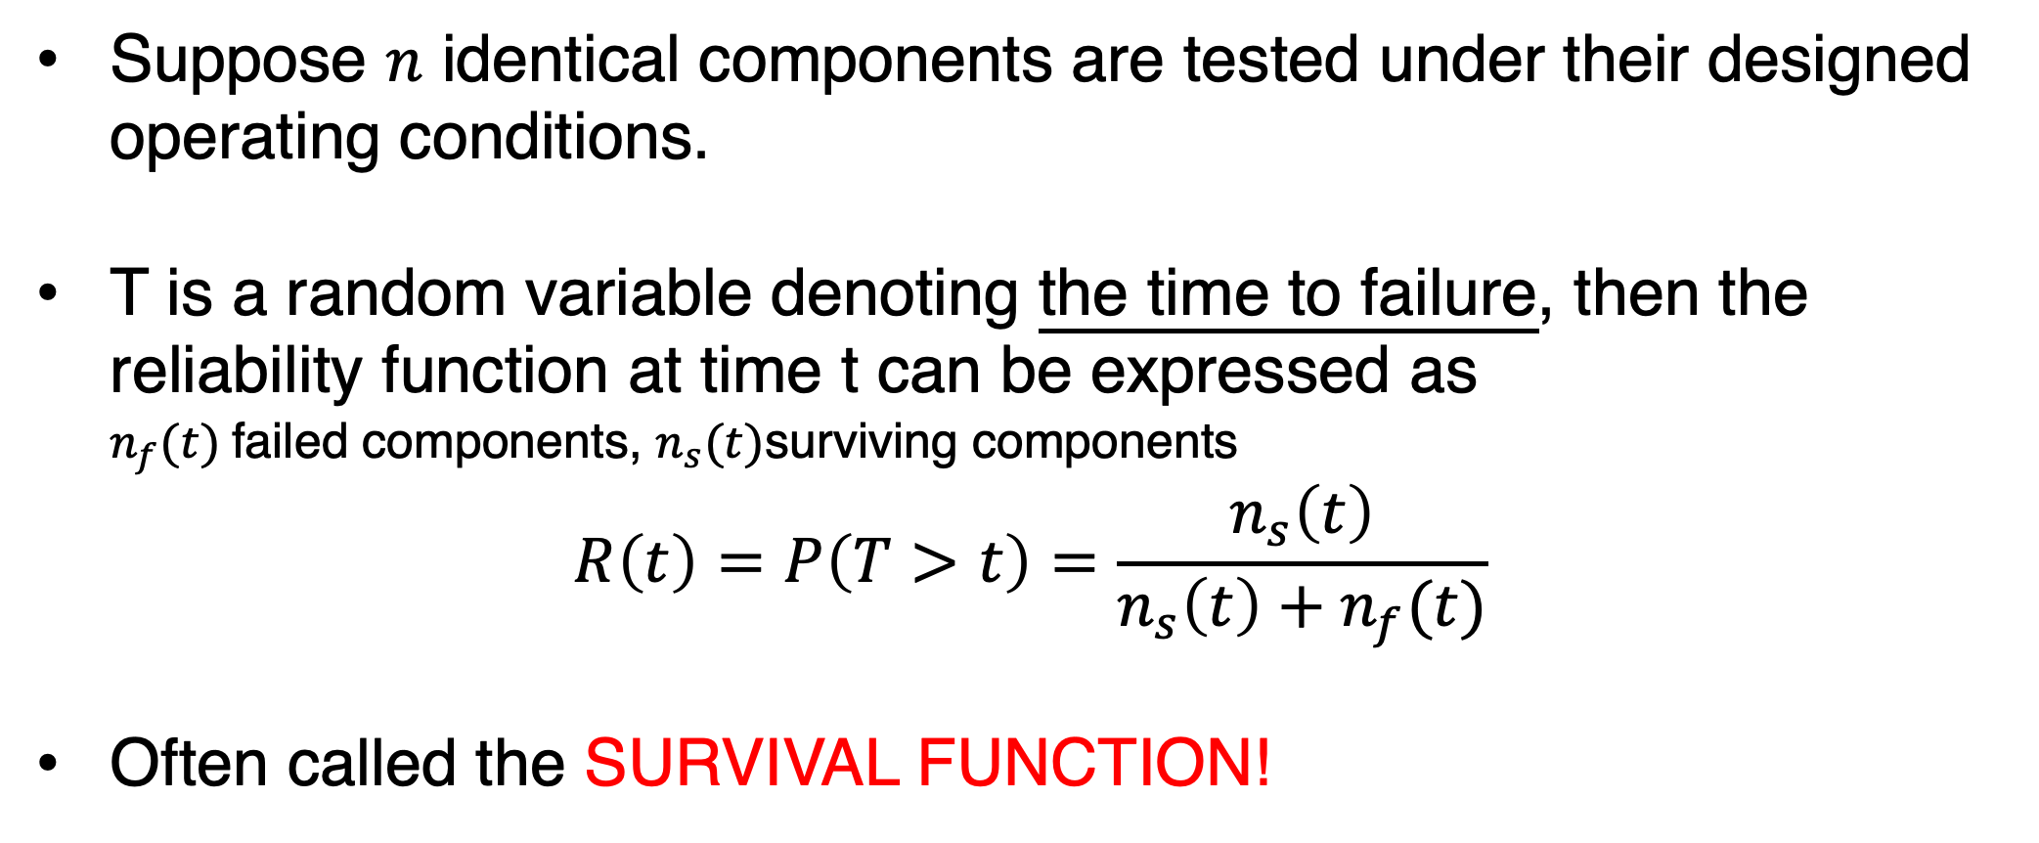
Suppose $n$ identical components are tested under their designed operating conditions.
T is a random variable denoting the time to failure, then the reliability function at time t can be expressed as $n_{f}(t)$failed components, $n_{s}(t)$surviving components
$$R\left(t\right)=P\left(T>t\right)=\frac{n_{s}\left(t\right)}{n_{s}\left(t\right)+n_{f}(t)}$$
Often called the SURVIVAL FUNCTION!

Slide 9
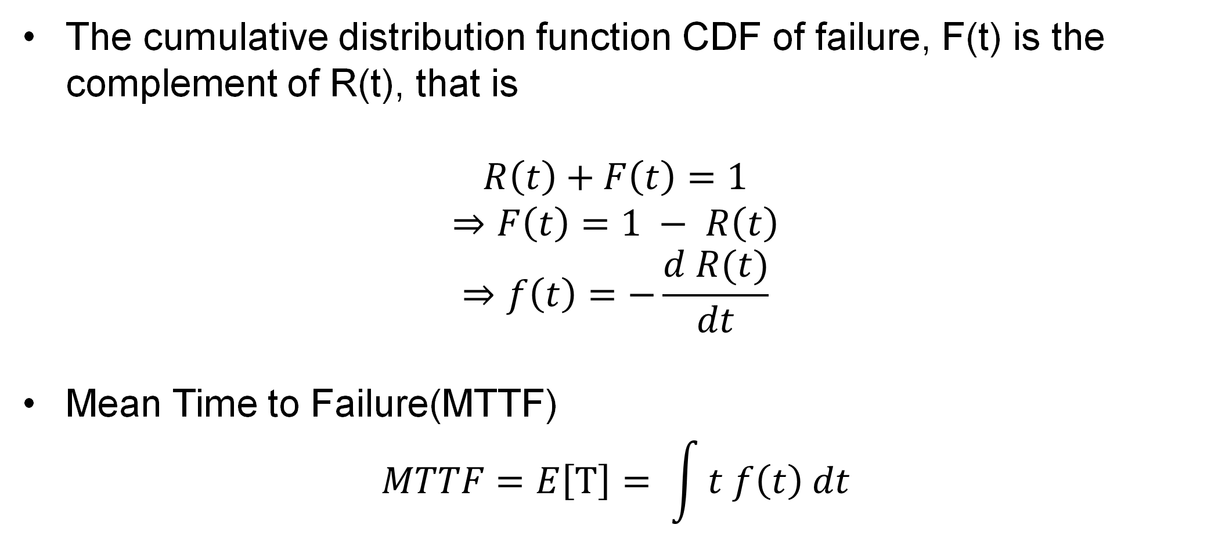
The cumulative distribution function CDF of failure, F(t) is the complement of R(t), that is
$$R\left(t\right)+F\left(t\right)=1$$
$$⇒F\left(t\right)=1 − R\left(t\right)$$
$$⇒f\left(t\right)=−\frac{d R(t)}{dt}$$
Mean Time to Failure(MTTF)
$$MTTF=E\left[T\right]= \int{t f\left(t\right) dt}$$

Slide 10
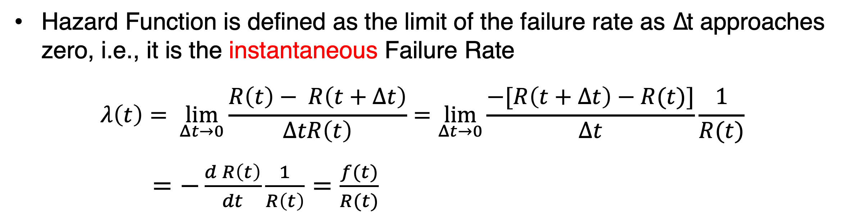
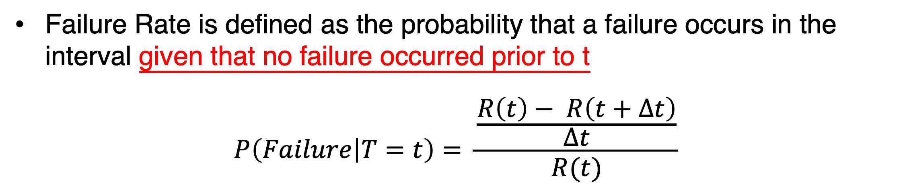
Failure Rate
Failure Rate is defined as the probability that a failure occurs in the interval given that no failure occurred prior to t
$$P\left(Failure | T=t\right)= \frac{\frac{R\left(t\right)− R\left(t+Δt\right)}{Δt}}{R(t)}$$
Hazard Rate
Hazard Function is defined as the limit of the failure rate as ∆t approaches zero, i.e., it is the instantaneous Failure Rate
$$λ\left(t\right)= \lim_{Δt→0}{\frac{R\left(t\right)− R\left(t+Δt\right)}{ΔtR\left(t\right)}}=\lim_{Δt→0}\frac{−[R\left(t+Δt\right)−R(t)]}{Δt}\frac{1}{R(t)}$$
$=−\frac{d R\left(t\right)}{dt}\frac{1}{R\left(t\right)}=\frac{f(t)}{R(t)}$

Slide 11
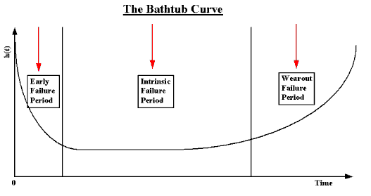
Bathtub Curve
The bathtub curve is a graphical representation commonly used in reliability engineering to illustrate the failure rate of a product or system over its lifecycle.

Slide 12
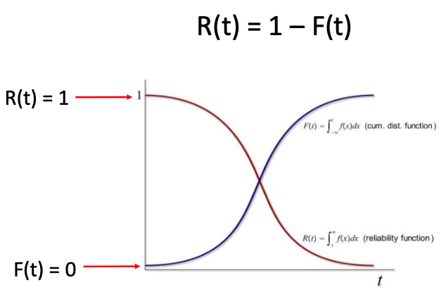
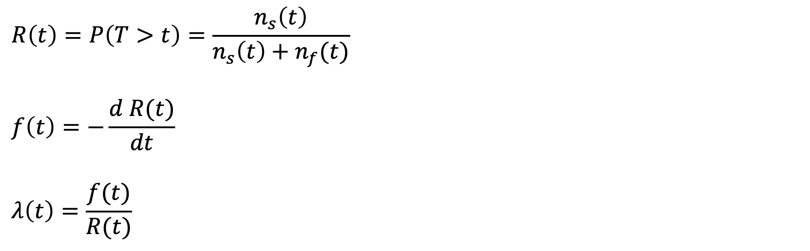
Summary
$$R\left(t\right)=P\left(T>t\right)=\frac{n_{s}\left(t\right)}{n_{s}\left(t\right)+n_{f}(t)}$$
$$f\left(t\right)=−\frac{d R(t)}{dt}$$
$$λ\left(t\right)=\frac{f(t)}{R(t)}$$

Slide 13
Likelihood Censor

Slide 14
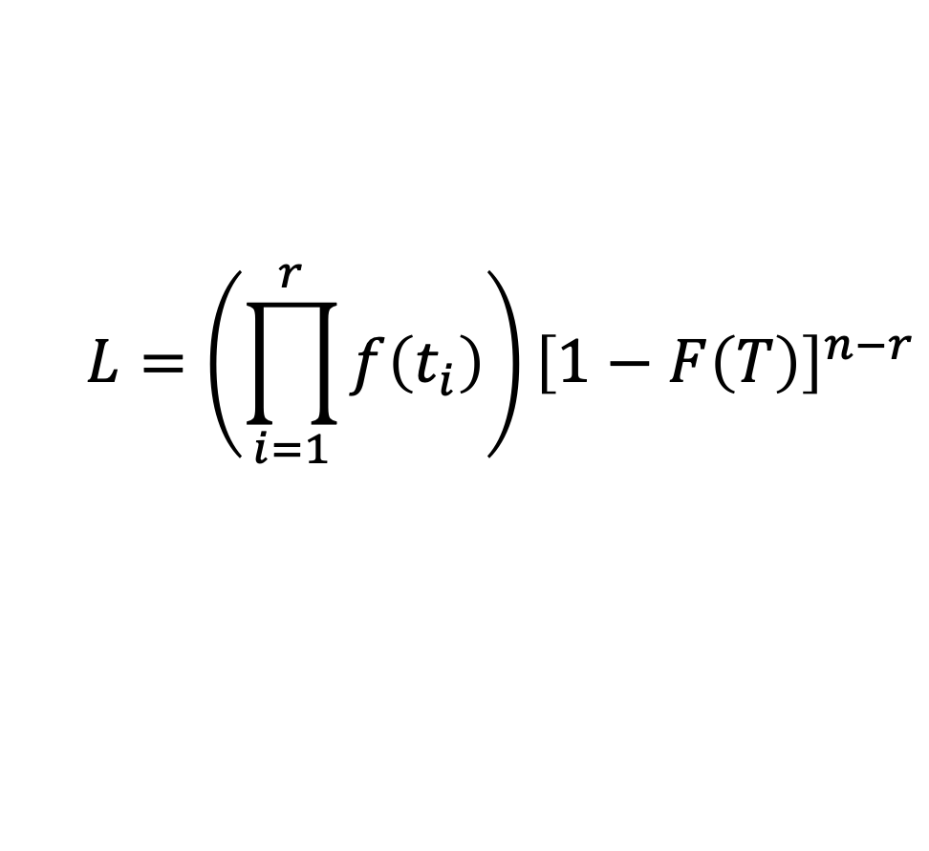
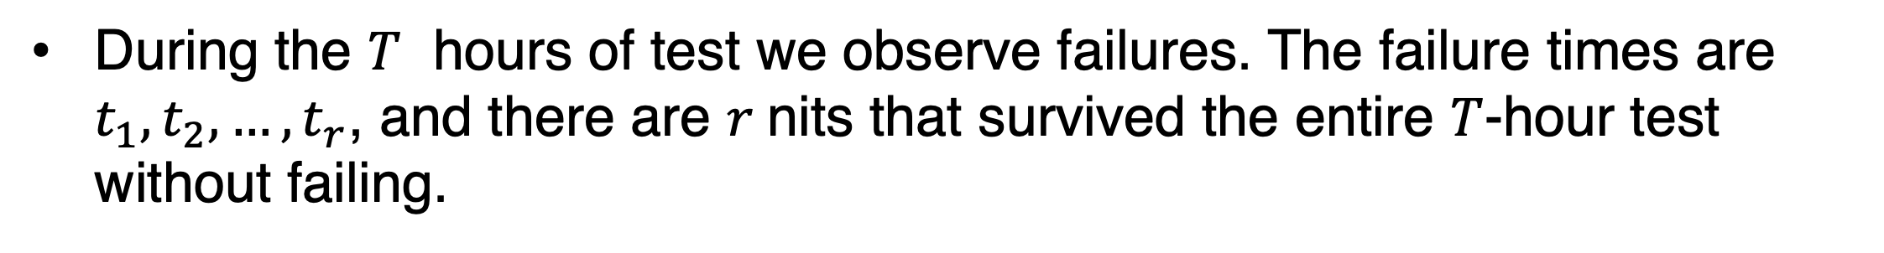
Censoring : Type I Data
During the $T$ hours of test we observe failures. The failure times are $t_{1}, t_{2}, …, t_{r}$, and there are $r$nits that survived the entire $T$-hour test without failing.
Censoring : Type II Data
We observe $t_{1}, t_{2}, …, t_{r}$ , where $r$ is specified in advance. The test ends at time 𝑇 = $t_{r}$, and (n-r) units have survived.
Likelihood Function
$$L=\left(\prod_{i=1}^{r}{f\left(t_{i}\right)}\right){\left[1−F\left(T\right)\right]}^{n−r}$$

Slide 15
Common Distribution

Slide 16
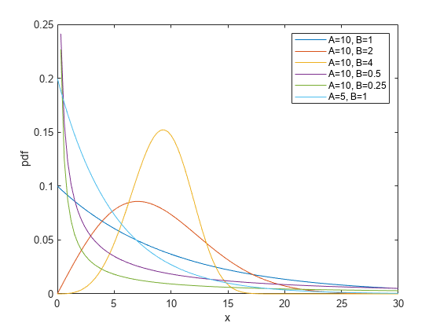
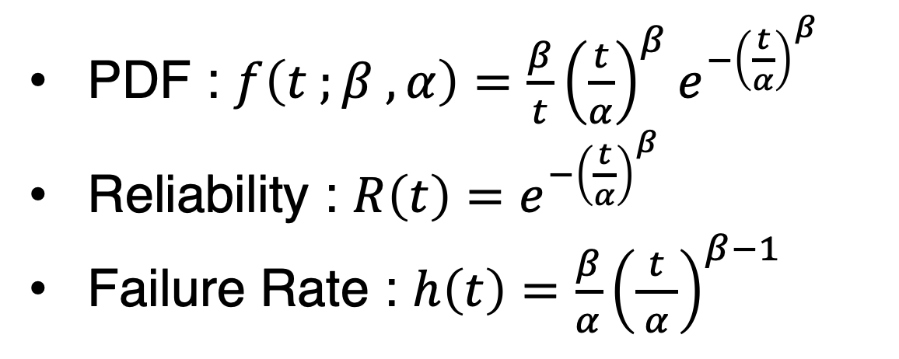
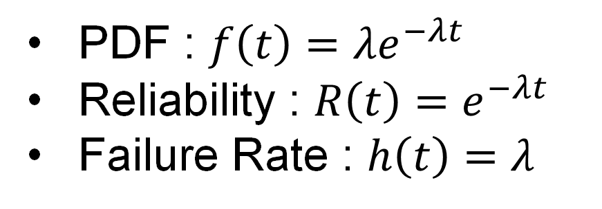
Exponential Distribution
PDF : $f\left(t\right)=λe^{−λt}$
Reliability : $R\left(t\right)=e^{−λt}$
Failure Rate : $h\left(t\right)=λ$
Weibull Distribution
PDF : $f\left(t ;β ,α\right)=\frac{β}{t}{\left(\frac{t}{α}\right)}^{β}e^{−{\left(\frac{t}{α}\right)}^{β}}$
Reliability : $R\left(t\right)=e^{−{\left(\frac{t}{α}\right)}^{β}}$
Failure Rate : $h\left(t\right)=\frac{β}{α}{\left(\frac{t}{ α }\right)}^{β−1}$

Slide 17
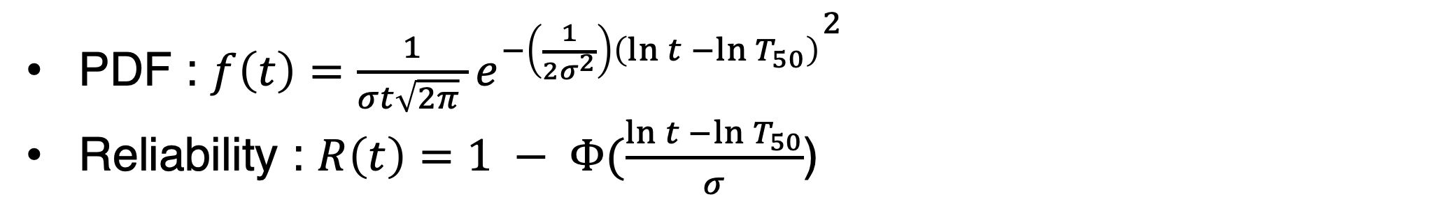
Lognormal Distribution
PDF : $f\left(t\right)=$ $\frac{1}{σt\sqrt{2π} }{e^{−\left(\frac{1}{2σ^{2}}\right)\left(\ln{t −\ln{T_{50}}}\right)}}^{2}$
Reliability : $R\left(t\right)=1 − Φ(\frac{\ln{t −\ln{T_{50}}}}{σ}$)

Slide 18
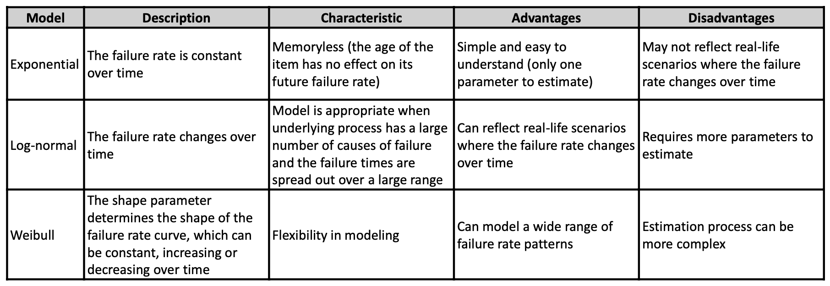

Slide 19
Bootstrap

Slide 20
Gerenal Idea :
The idea of bootstrap sampling is to simulate the repeated sampling process
and use the information from the distribution of appropriate statistics in the
bootstrap samples to compute the needed confidence interval, reducing the
reliance on large-sample approximations.

Slide 21
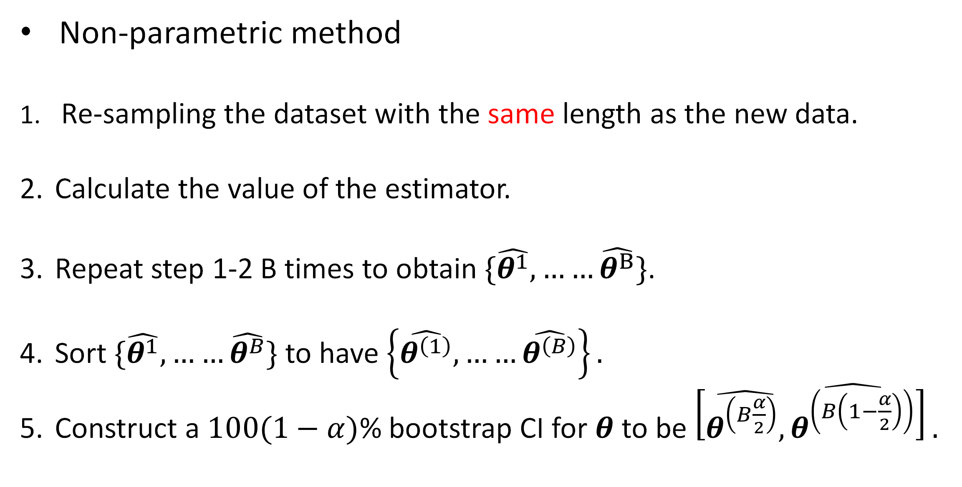
Non-parametric method
Re-sampling the dataset with the same length as the new data.
Calculate the value of the estimator.
Repeat step 1-2 B times to obtain $\{\hat{θ^{1}}, ……\hat{θ^{B}}\}$.
Sort $\{\hat{θ^{1}}, ……\hat{θ^{B}}\}$ to have $\left\{\hat{θ^{\left(1\right)}}, ……\hat{θ^{\left(B\right)}}\right\}.$
Construct a $100(1−α)$% bootstrap CI for $θ$ to be $\left[\hat{θ^{\left(B\frac{α}{2}\right)},}\hat{θ^{\left(B\left(1−\frac{α}{2}\right)\right)}}\right].$

Slide 22
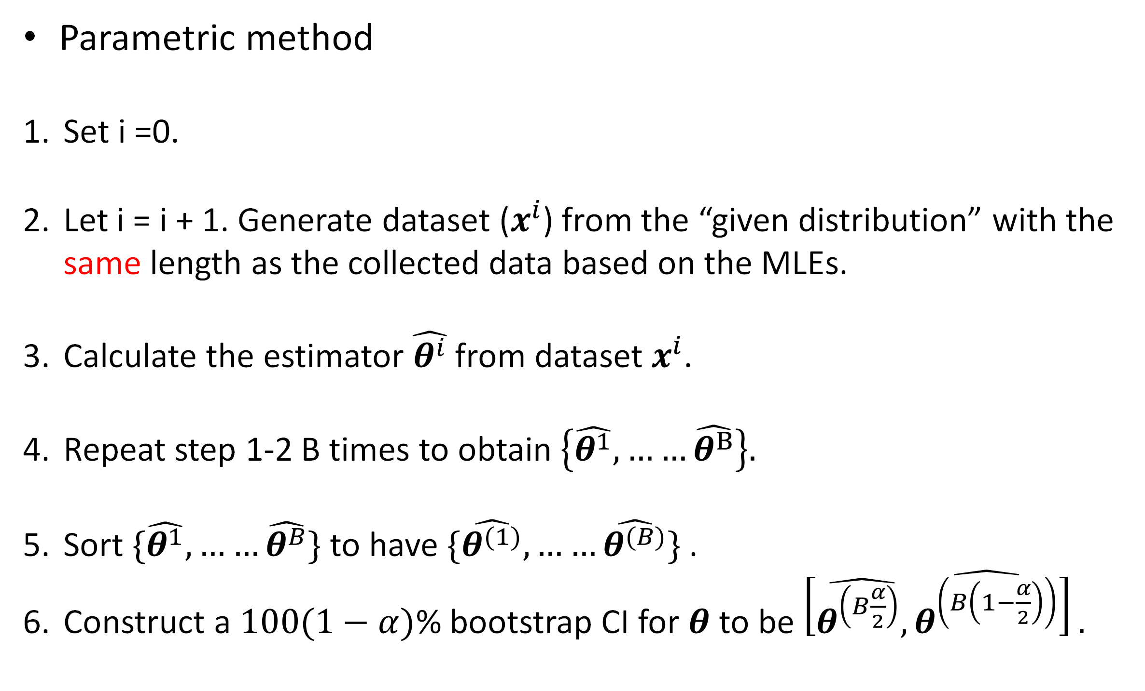
Parametric method
Set i =0.
Let i = i + 1. Generate dataset ($x^{i}$) from the “given distribution” with the same length as the collected data based on the MLEs.
Calculate the estimator $\hat{θ^{i}}$ from dataset $x^{i}$.
Repeat step 1-2 B times to obtain $\left\{\hat{θ^{1}}, ……\hat{θ^{B}}\right\}.$
Sort $\{\hat{θ^{1}}, ……\hat{θ^{B}}\}$ to have $\{\hat{θ^{(1)}}, ……\hat{θ^{(B)}}\}$ .
Construct a $100(1−α)$% bootstrap CI for $θ$ to be $\left[\hat{θ^{\left(B\frac{α}{2}\right)},}\hat{θ^{\left(B\left(1−\frac{α}{2}\right)\right)}}\right].$

Slide 23
Degradation

Slide 24

What is degradation ?

Slide 25
It is the difficulty in obtaining sufficient time-to-failure data to efficiently estimate a product’s life.
Quality characteristic (QC) : easily to be observed. (ex. The operating current of the laser device, the voltage of the battery, etc.)
If quality characteristic (QC) exist, whose degradation path can be related to reliability, an alternative approach can be used to collect the degradation data to predict a product’s lifetime distribution.

Slide 26
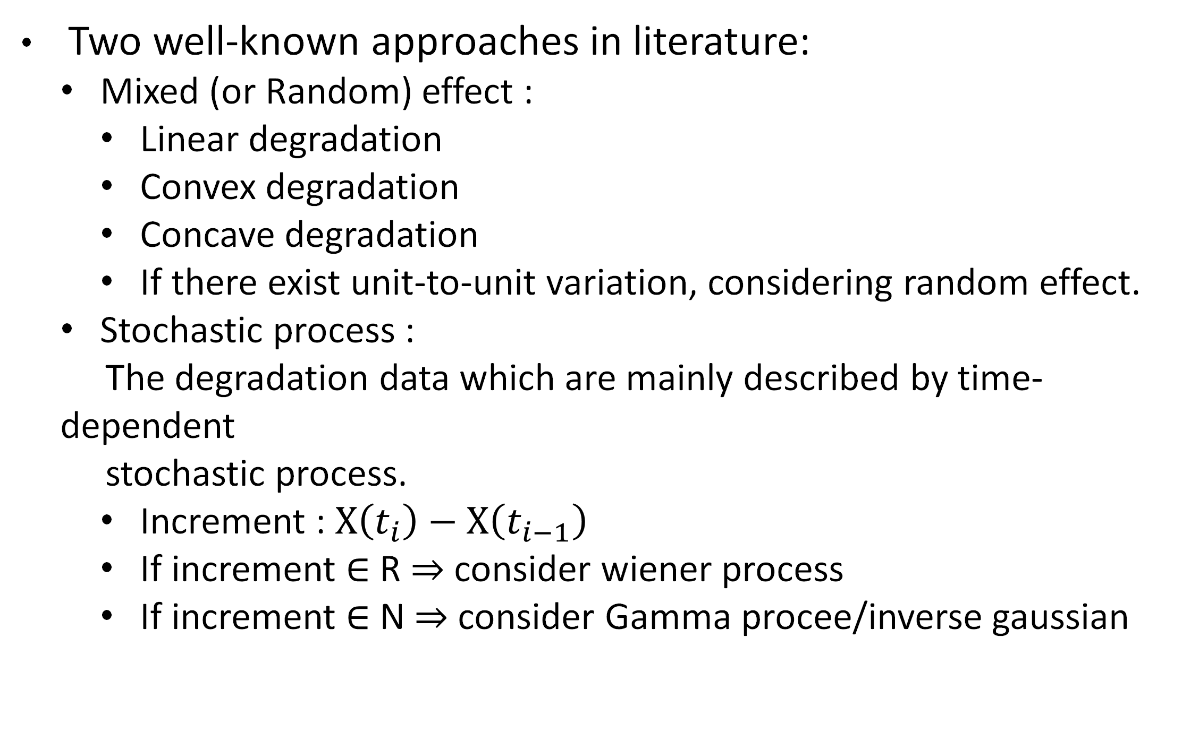
Two well-known approaches in literature:
Mixed (or Random) effect :
Linear degradation
Convex degradation
Concave degradation
If there exist unit-to-unit variation, considering random effect.
Stochastic process :
The degradation data which are mainly described by time-dependent
stochastic process.
Increment : $X\left(t_{i}\right)−X\left(t_{i−1}\right)$
If increment $∈$ R $⇒$ consider wiener process
If increment $∈$ N $⇒$ consider Gamma procee/inverse gaussian

Slide 27
Advantages and Disadvantages between two model
Mixed (or Random) effect
Advantages : Easily to compute.
Disadvantages : Not usually fit the dataset well.
Stochastic process
Advantages : Simulating the uncertainty of the real data, different stochastic process can choose.
Disadvantages : computational complexity, model selection and interpretation.

Slide 28
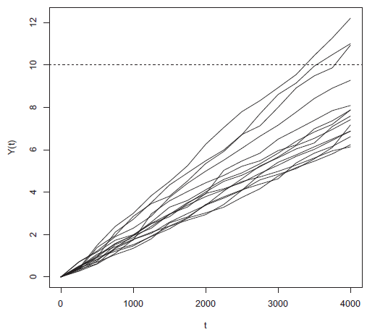
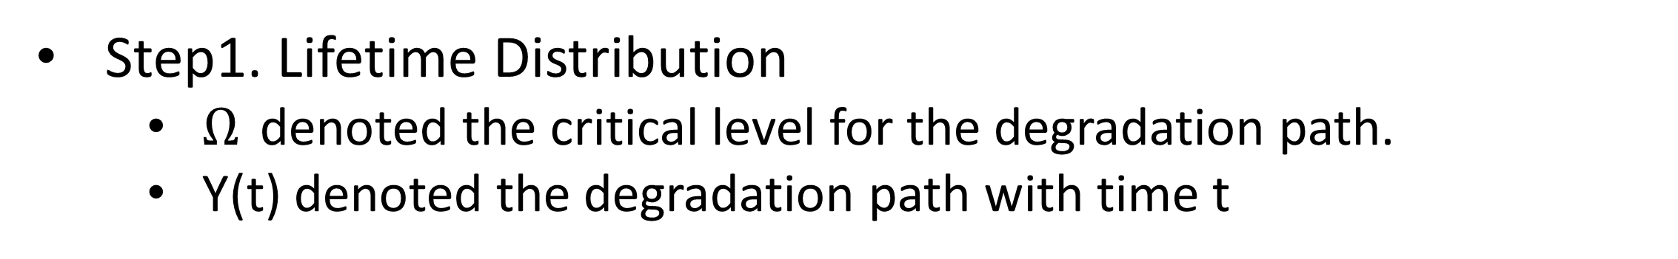
Step1. Lifetime Distribution
$Ω$ denoted the critical level for the degradation path.
Y(t) denoted the degradation path with time t
$T$ = inf{ t | Y(t) > ω }

Slide 29
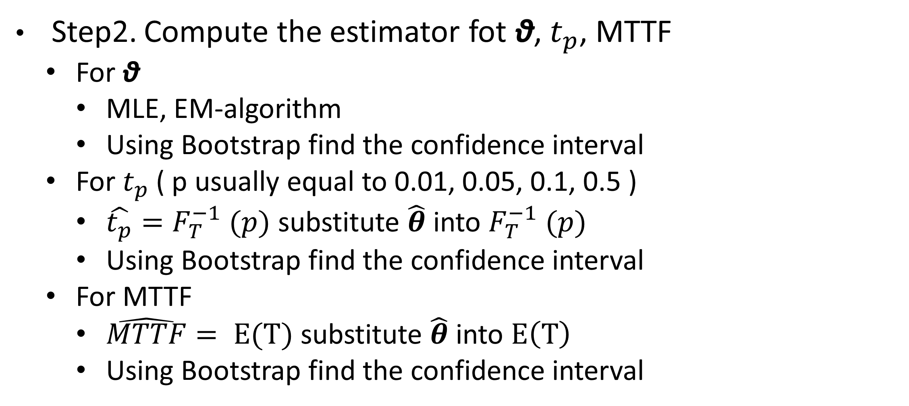
Step2. Compute the estimator fot θ, $t_{p}$, MTTF
For θ
MLE, EM-algorithm
Using Bootstrap find the confidence interval
For $t_{p}$( p usually equal to 0.01, 0.05, 0.1, 0.5 )
$\hat{t_{p}}=F_{T}^{−1} (p)$ substitute $\hat{θ}$ into $F_{T}^{−1} (p)$
Using Bootstrap find the confidence interval
For MTTF
$\hat{MTTF}= E(T)$ substitute $\hat{θ}$ into $E\left(T\right)$
Using Bootstrap find the confidence interval

Slide 30
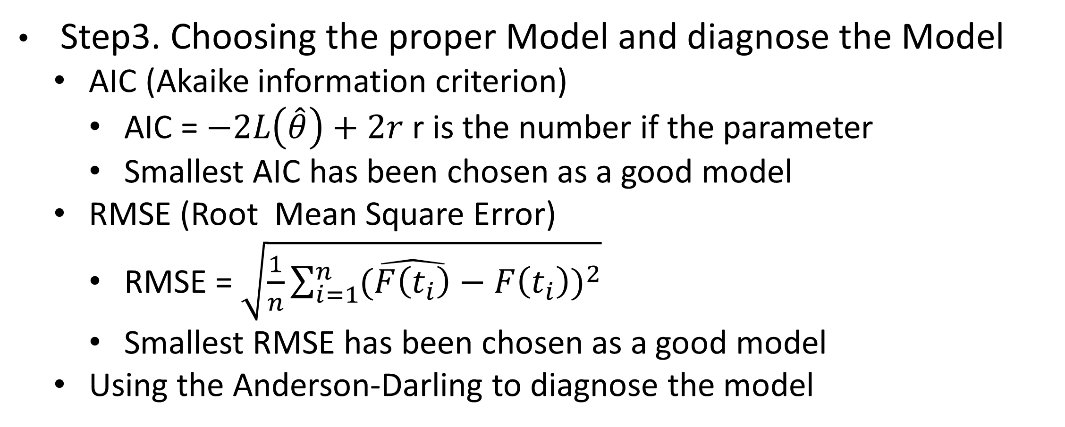
Step3. Choosing the proper Model and diagnose the Model
AIC (Akaike information criterion)
AIC = $−2L\left(\hat{θ}\right)+2r$ r is the number if the parameter
Smallest AIC has been chosen as a good model
RMSE (Root Mean Square Error)
RMSE = $\sqrt{\frac{1}{n}\sum_{i=1}^{n}{{(\hat{F\left(t_{i}\right)}−F\left(t_{i}\right))}^{2}}}$
Smallest RMSE has been chosen as a good model
Using the Anderson-Darling to diagnose the model

Slide 31
Example

Slide 32
We use the Laser data in Meeker & Escobar
QC : the operating current of laser device.
15 units in the experiment.
Threshold : If the percent increasing in operating current reach 10%, this device is consider to be failure.
Measured frequency of its current is 250 hours.
The experiment was terminated at 400 hours.

Slide 33
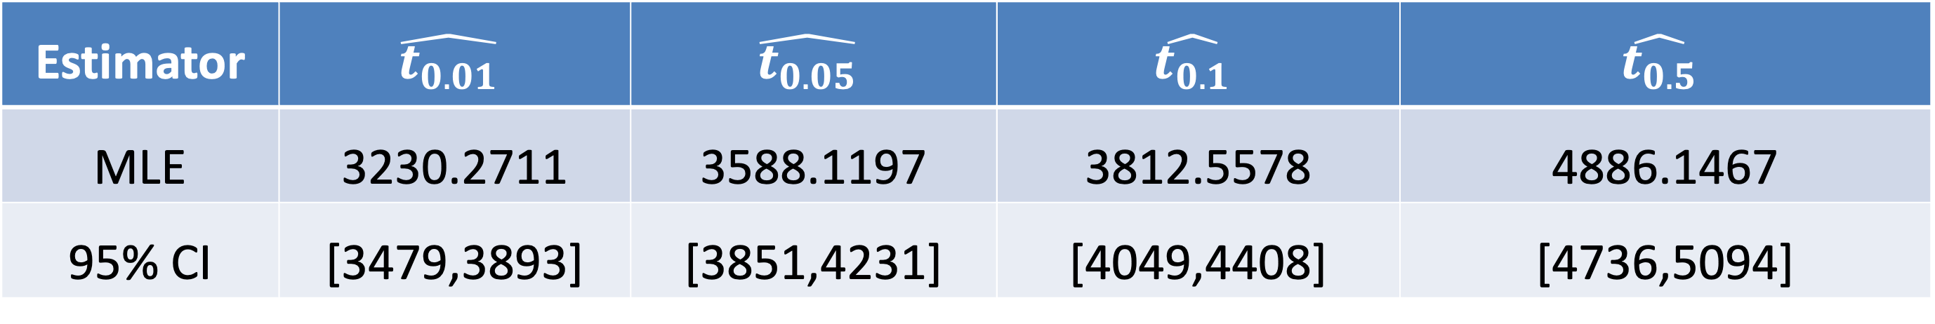
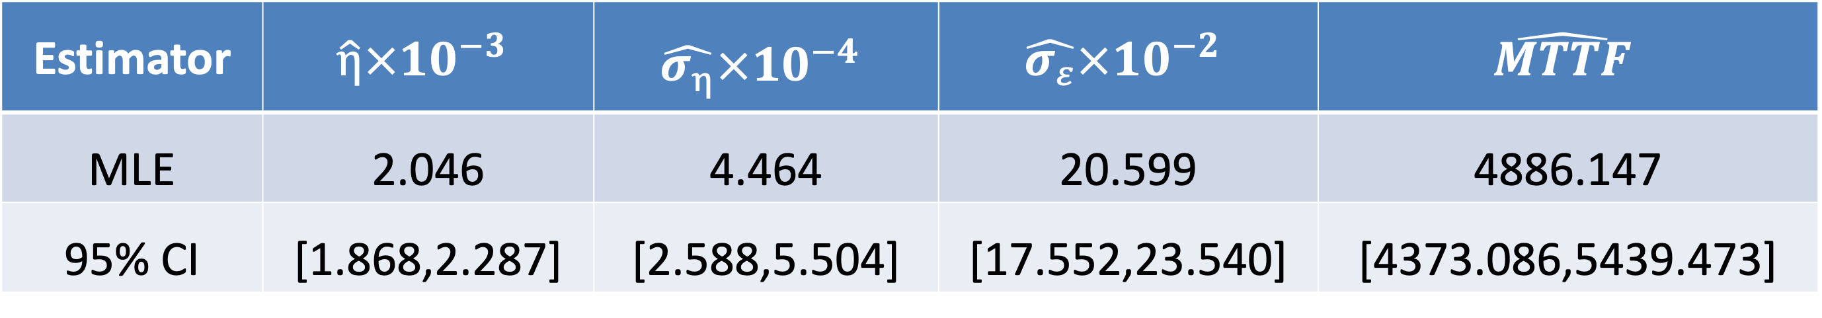
Model 1 : $Y\left(t\right)= Θt+ε$ , assume $Θ\sim N(η,σ_{η}^{2})$ and $ε\sim N(0,σ_{ε}^{2})$
Estimator | $$\hat{η}×{10}^{−3}$$ | $$\hat{σ_{η}}×{10}^{−4}$$ | $$\hat{σ_{ε}}×{10}^{−2}$$ | $$\hat{MTTF}$$
MLE | 2.046 | 4.464 | 20.599 | 4886.147
95% CI | [1.868,2.287] | [2.588,5.504] | [17.552,23.540] | [4373.086,5439.473]
Estimator | $$\hat{t_{0.01}}$$ | $$\hat{t_{0.05}}$$ | $$\hat{t_{0.1}}$$ | $$\hat{t_{0.5}}$$
MLE | 3230.2711 | 3588.1197 | 3812.5578 | 4886.1467
95% CI | [3479,3893] | [3851,4231] | [4049,4408] | [4736,5094]
RMSE | AD Test
0.0905 | 0.814

Slide 34
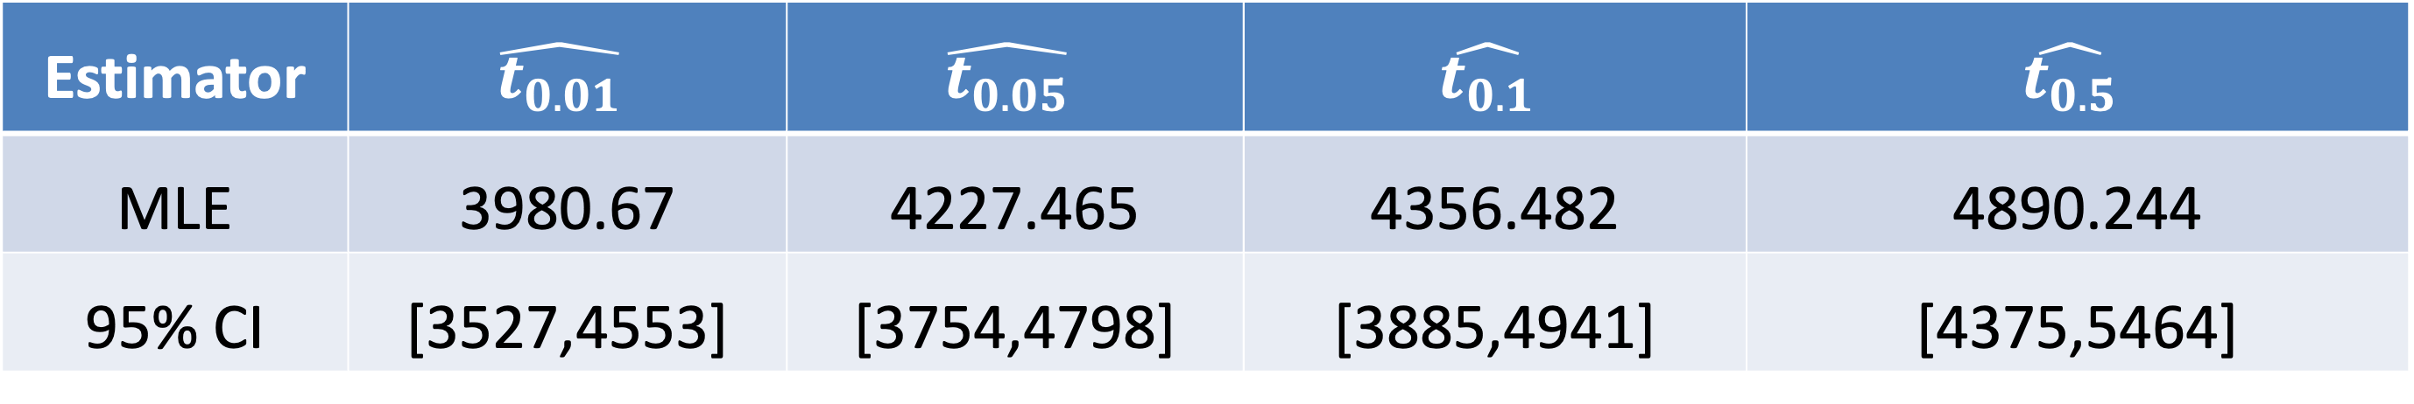
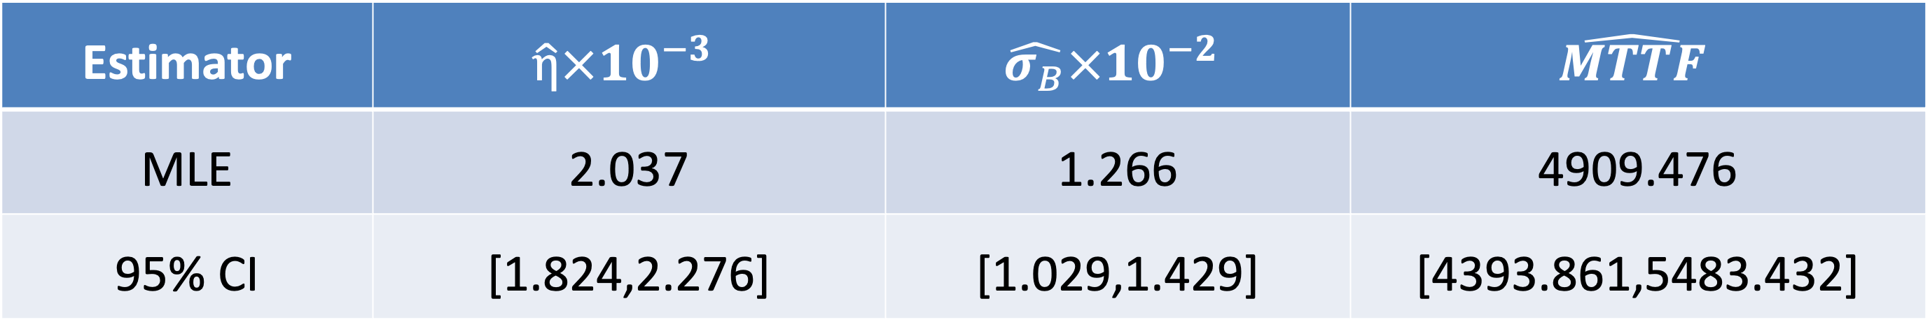
Model 2: $Y\left(t\right)= Θt+σ_{B}B(t)$ , assume $Θ$ is fixed and $B\left(t\right)$ is a standard Brownian motion, where standard Brownaian motion $⇒$ increment $\sim N(0,1)$)
Estimator | $$\hat{η}×{10}^{−3}$$ | $$\hat{σ_{B}}×{10}^{−2}$$ | $$\hat{MTTF}$$
MLE | 2.037 | 1.266 | 4909.476
95% CI | [1.824,2.276] | [1.029,1.429] | [4393.861,5483.432]
Estimator | $$\hat{t_{0.01}}$$ | $$\hat{t_{0.05}}$$ | $$\hat{t_{0.1}}$$ | $$\hat{t_{0.5}}$$
MLE | 3980.67 | 4227.465 | 4356.482 | 4890.244
95% CI | [3527,4553] | [3754,4798] | [3885,4941] | [4375,5464]
RMSE | AD Test
0.2078 | 0.0740

Slide 35
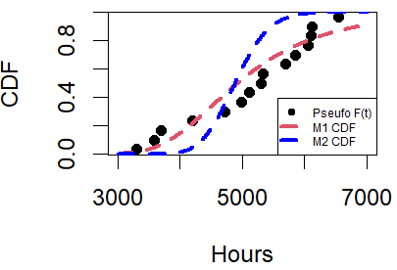
M1 is fitted better than M2, but is not adequately.
Since the increment in the laser data is positive, maybe we can try to use the Gamma process to fit the model or take both stochastic process and random effect into consideration.

Slide 36
References
https://www.itl.nist.gov/div898/handbook/index.htm
Meeker WQ, Escobar LA. “Statistical Methods for Reliability Data”.
C. Y. Peng and S. T. Tseng, “Mis-specification analysis of linear degradation models”.
Y. F. Wang, Y. F. Huang and W. C. Liao, “Degradation analysis on trend gamma process”.
資工系 許書涵老師—可靠度資料分析

